Slide 1

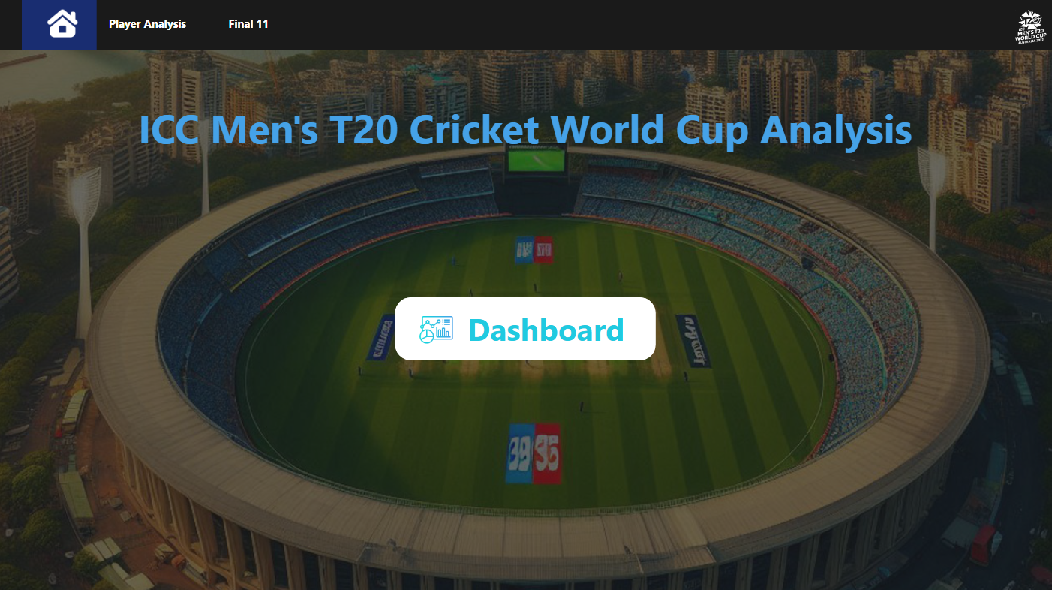
Presented by Md Inamul Hauque

Slide 2
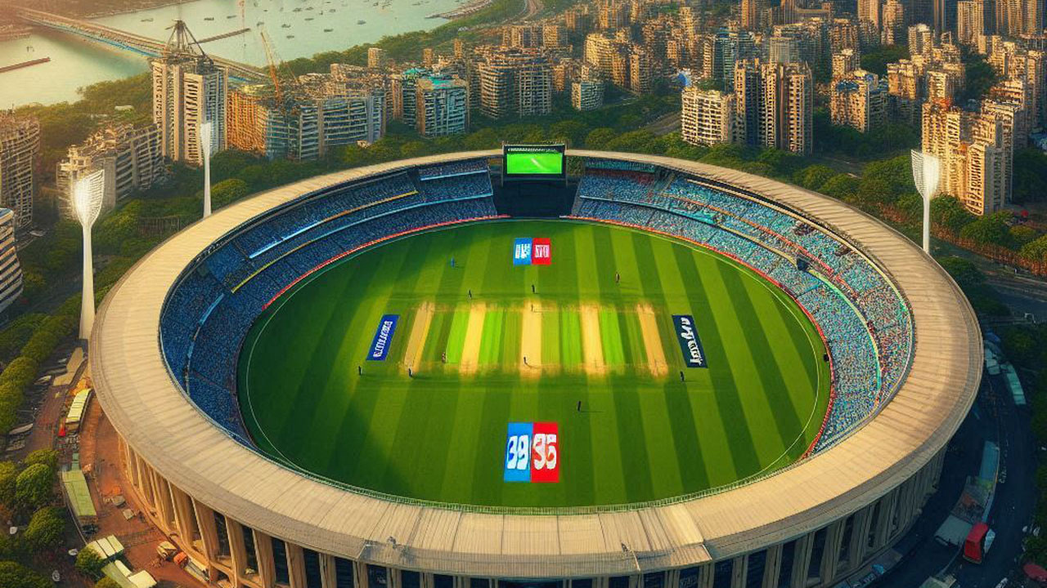
Problem Statement
Planet Sporta has Challenged planet Earth to play cricket, and Nick Fury has assembled the secret agents of field to work this project to find out the best 1 players based on the T20 world cup cricket data.
The team should be able to score at least 180 runs on an average
They should be to defend 150 runs on an average

Slide 3
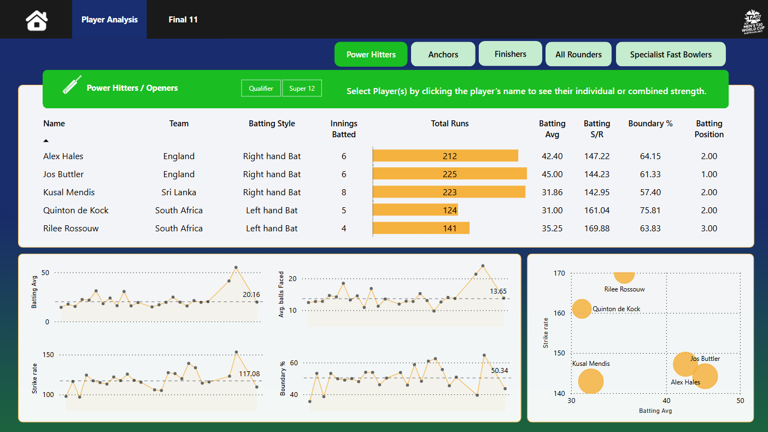
This visualization shows the top players based on innings batted, batting average, batting strike rate, boundary percentage, and batting position.
By hovering the cursor over a player's name, you can see individual player performance match by match.

Slide 4
These are the trends of batting average, strike rate, average balls faced, and boundary percentage of the players, showing how they performed match by match. over the course of the season. Analyzing these metrics provides a comprehensive view of each player's performance and highlights their strengths and weaknesses in various situations.

Slide 5
The scatter plot analyzes a player's batting average and strike rate alongside innings batted, boundary percentage, and batting position. It reveals trends in performance, such as how a high batting average with a low strike rate suggests contact skills but a lack of aggression, while high averages and strike rates indicate effective scoring potential.

Slide 6
Power Hitters

Slide 7
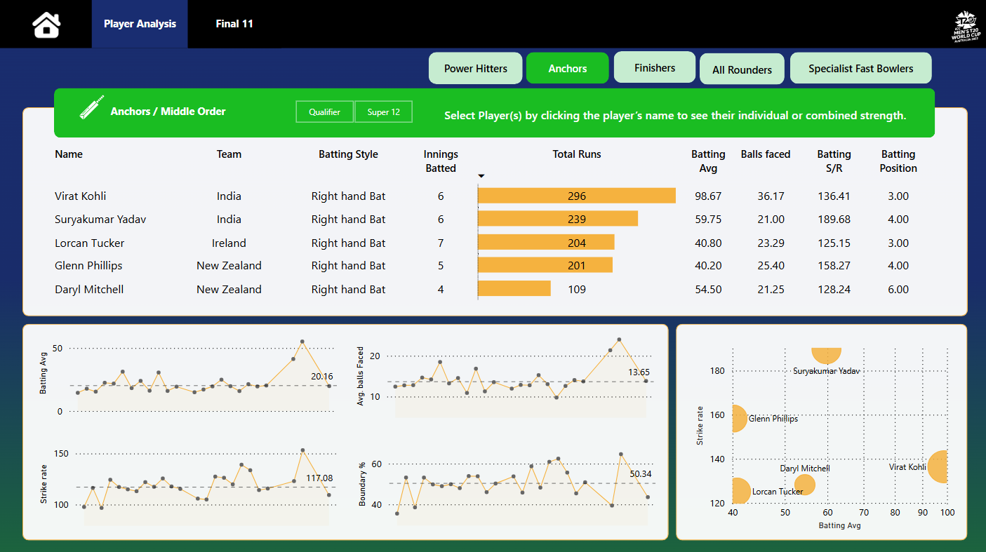
Anchors

Slide 8
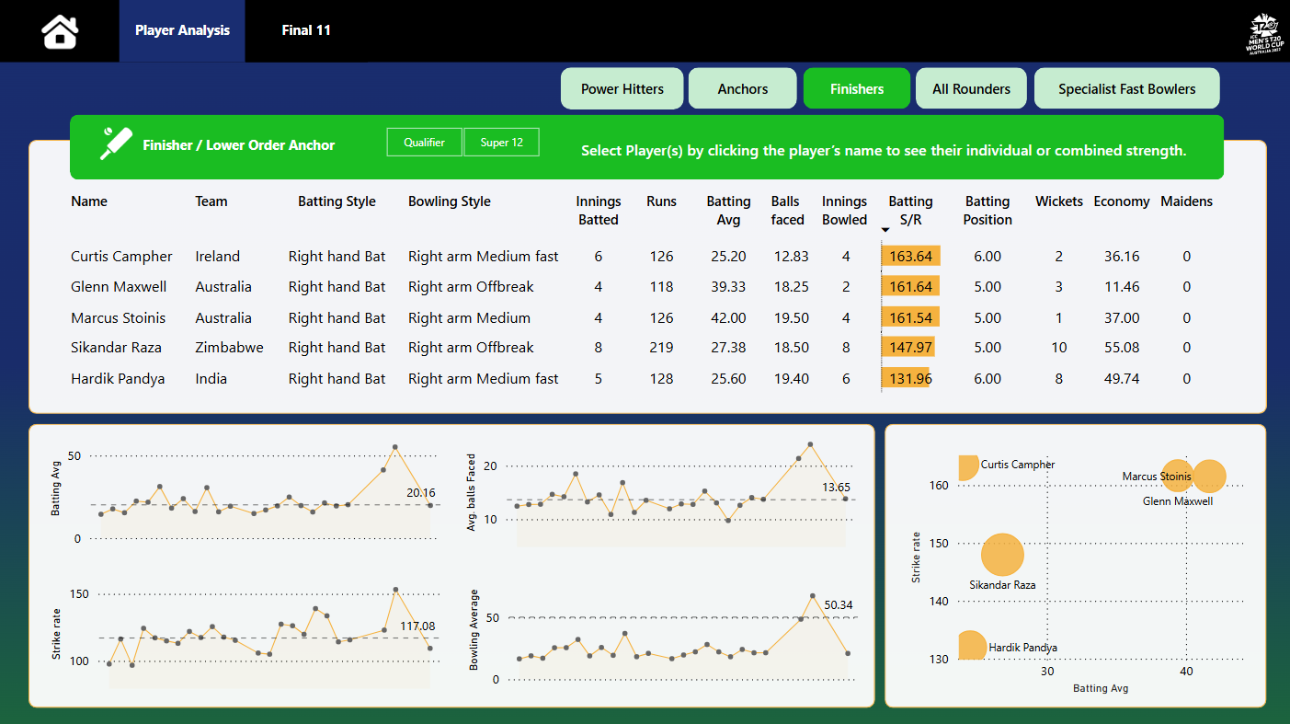
Finishers

Slide 9
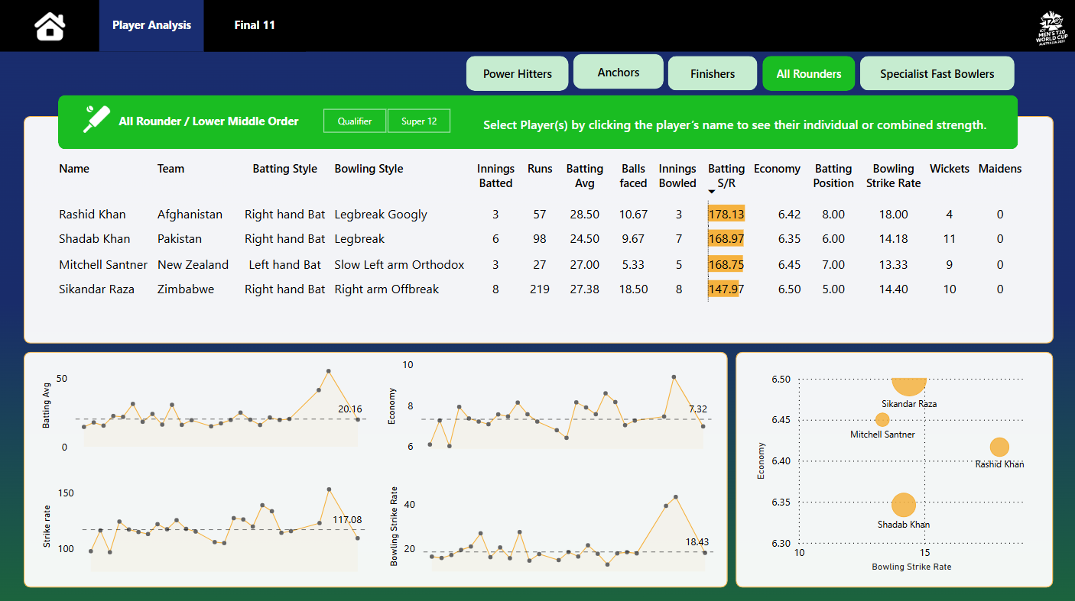
All Rounders

Slide 10
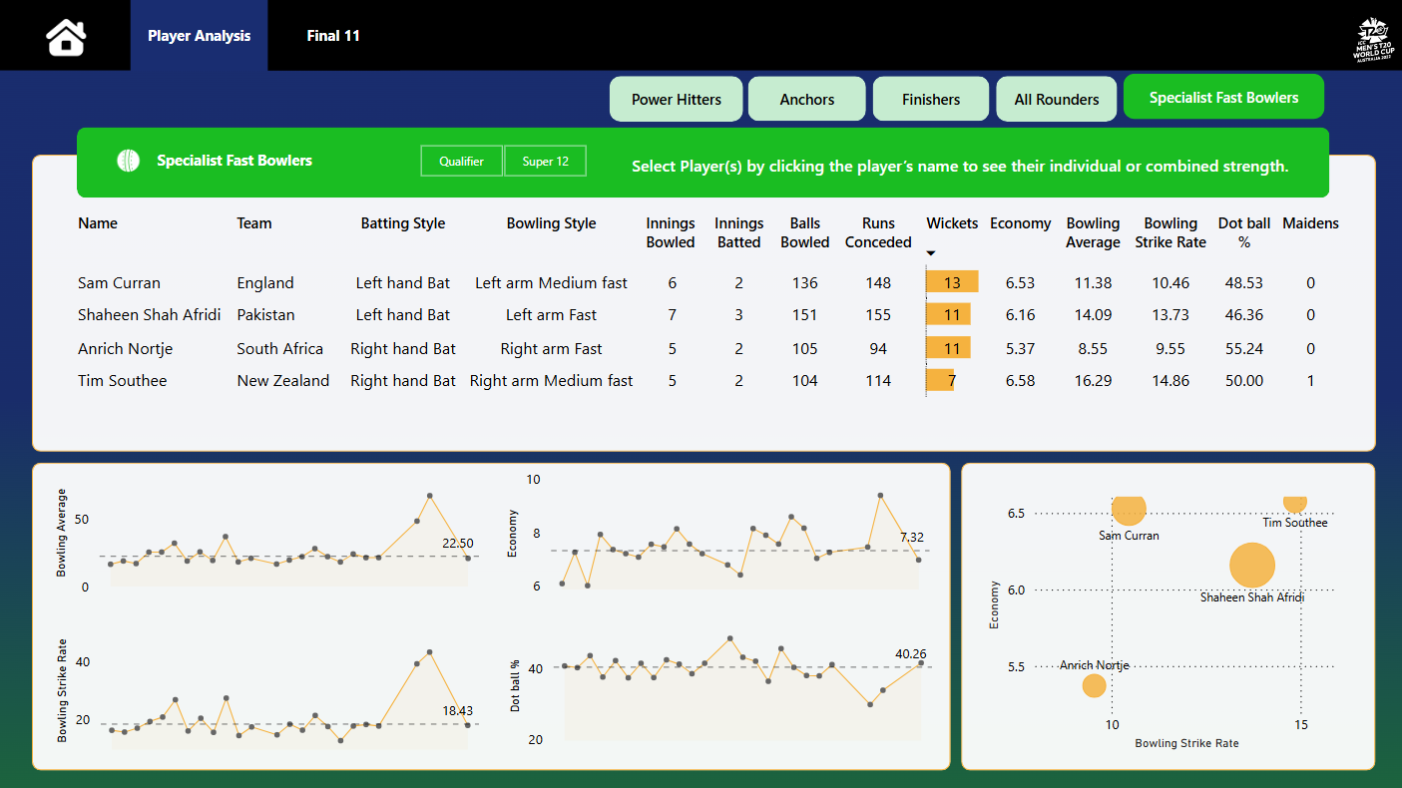
Specialist FastBowlers

Slide 11
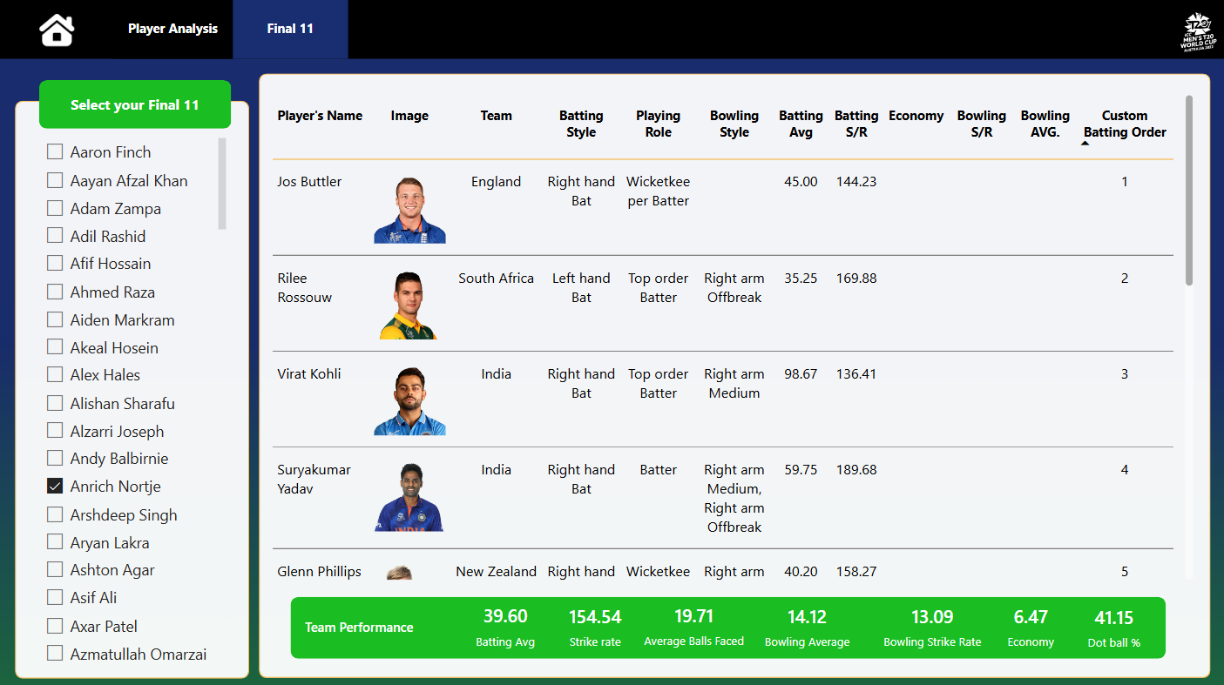
Best 11 Players

